Slide 1
Sympathetic Vs Parasympathetic
Review 2/4

Slide 2
Autonomic Review:
Sensory
Afferent
Motor
Efferent

Slide 3
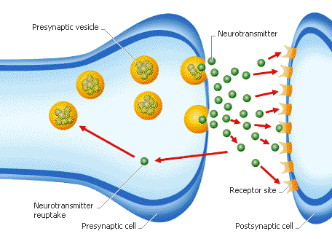
Neurotransmitter

Slide 4
Afferent
Control center
Efferent
Carotid
Sinus
Glossopharyngeal
Nerve (IX)
Parasympathetic
Neuron
Mendulla
(Vasomotor
Center,
NTS…)
Heart
Aortic
Arch
Veins
Sympathetic
Neuron
Vagus
Nerve (X)
Atrial
Receptors
Arterioles
Notes:
Herings nerves to the Glossopharyngeal nerve
Nucleus Tractus Solitarii
Cardioinhibitory area
Interneurons

Slide 5
Compare and contrast autonomic effect on heart rate
 | Parasympathetic | Sympathetic
Parts of the heart affected | Manly on SA or AV nodes | On all parts, strongly on ventricular muscles
Neurotransmitter released | Acetylcholine | Norepinephrine
What it does to resting membrane potential | Lowers | Raises
How | ↑ Permiability to K+ ions- out of cell | ↑ permeability to Ca+ and Na+ - into cell **
Easier or Harder to reach threshold | Harder | Easier
Changes to Heart Rate | Decrease | Increase

Slide 6
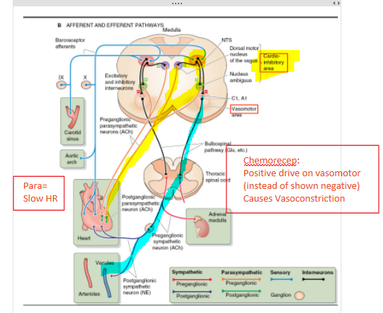
Abnormal Low O2, during forced Apnea
Low O2
Detected by Peripheral chemoreceptors
Send signal up the Afferent pathway
Processed in the Mendulla
Signal works like the baroreceptors, causes a slow down in heart rate [bradycardia]
Chemoreceptors have a positive effect on the vasomotor center- vasoconstriction
What if you can breath?
Increased CO2 and Low O2 cause you to breath more [more exchange]
The stretch of the lungs sends a signal to override the cardio-inhibitory center
Causes Trachycardia
Also, lowers CO2, raising pH, which also overrides the cardio-inhibitory center
Notes:
Baroreceptors are a negative drive on the vasomotor center [vasodilation]
Chemoreceptors are a positive drive on the vasomotor center [vasoconstriction]

Slide 7
After 10 minutes of jogging Ben’s sympathetic system releases acetylcholine to cause vasodilation, where and why?
Notes:
Vasodilation in the muscles- sympathetic reaction- more blood to the muscles

Slide 8
Your classmate is wearing a shirt with a tight collar. He hears a noise behind him and forcefully turns his head around as much as possible to see the problem. He then faints, what condition could he have?
Notes:
Unusually sensitive carotid sinus – the pressure from the compression in the neck tells the medulla to lower blood pressure when it doesn’t need to be.

Slide 9
You enter your physiology class and discover there is a pop quiz. You then experience an alarm reaction. What will happen to your Arterial Pressure?
Notes:
Would increase. Sympathetic response to get more blood to your muscles to fight

Slide 10
The same patient, with higher than normal atrial pressure, also has a 70% increase in heart rate. Why?
Notes:
15% increase from direct stretch reflex from the Sinus Node
40-60% from the Bain-Bridge reflex
vagus nerve to Medulla to vagal and sympathetic nerves to increase heart rate and strength of heart contraction

Slide 11
Your patient’s arterial pressure reads 73 mm Hg. Why would this trigger your chemoreceptors?
Notes:
Chemoreceptors – the flow would decrease, lowering the amount of oxygen and raising the CO2 and H ions

Slide 12
After a patients atrial pressure has risen, she notices a rise in urine production. Why would this be a side effect, and what two processes lead to this?
Notes:
Too much fluid – the body’s reaction is to get rid of some
Increase filtration
Dilation of afferent arterioles in the kidneys
Dec in resistance
Pressure rises
Filtration increases
Reduce reabsorption
The atria sends a signal to the hypothalamus to stop making antidiuretic hormone

