Slide 1
Protein Digestion and Liver function

Slide 2
Protein Digestion
Where does most of the digestion occur?
in the stomach and small intestines
What is needed in the stomach for digestion to occur?
hydrochloric acid and pepsin
What are the two groups of protein enzymes after the stomach?
pancreatic secretions and enterocytes

Slide 3
Acid Secretion- Parietal cells
Stimulation
Acetylcholine
Gastrin
Histamine
Inhibitory
Somatostatin
Secretin
GIP/ GDIP
CCK

Slide 4
Fill in arrows
Vagus Nerve
Somatostatin
Corpus D cells
HCl
Parietial Cells
Histamine
ECL cells
Secretin
CCK
GIP/GDIP
Duodenum
Somatostatin
Antrum D cells
Gastrin
Antrum G cells

Slide 5
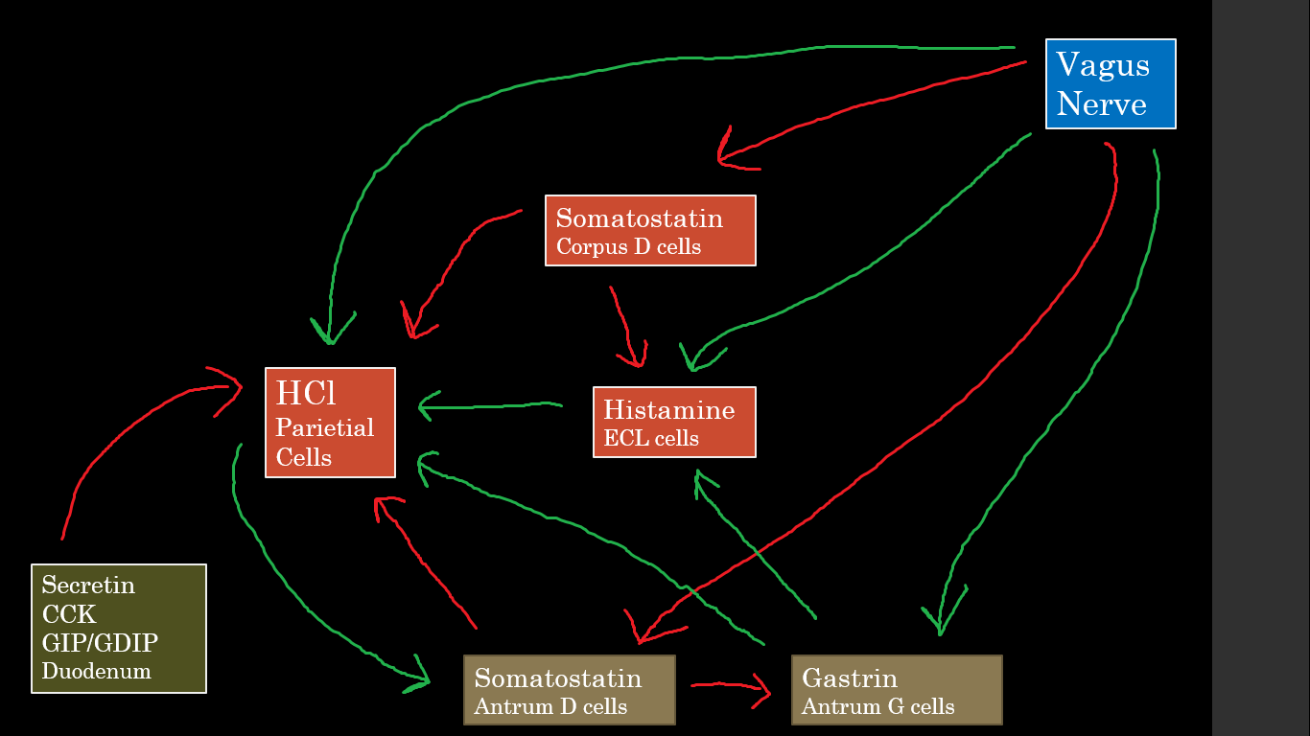
Vagus Nerve
Somatostatin
Corpus D cells
HCl
Parietial Cells
Histamine
ECL cells
Secretin
CCK
GIP/GDIP
Duodenum
Somatostatin
Antrum D cells
Gastrin
Antrum G cells

Slide 6
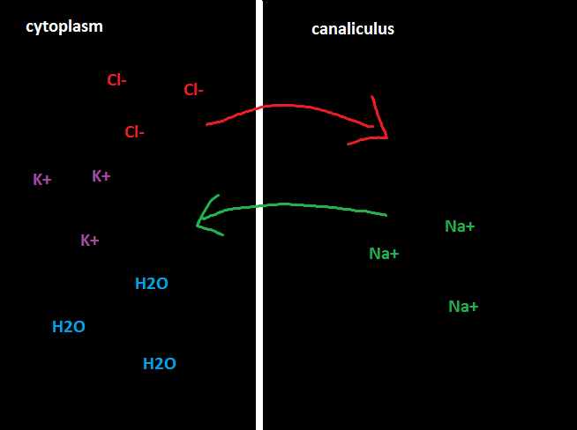
Acid secretion from the Parietal Cells

Slide 7
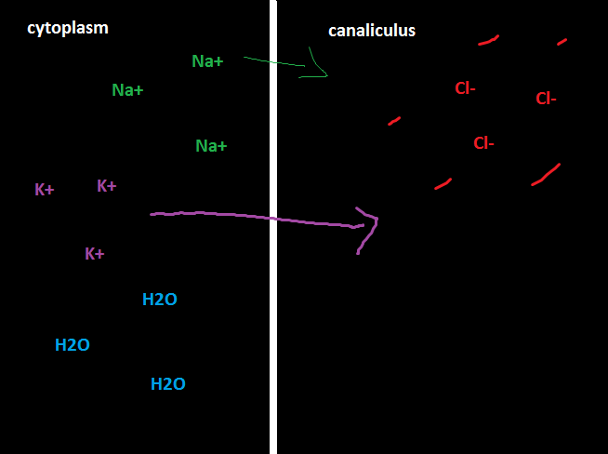
Acid secretion from the Parietal Cells

Slide 8
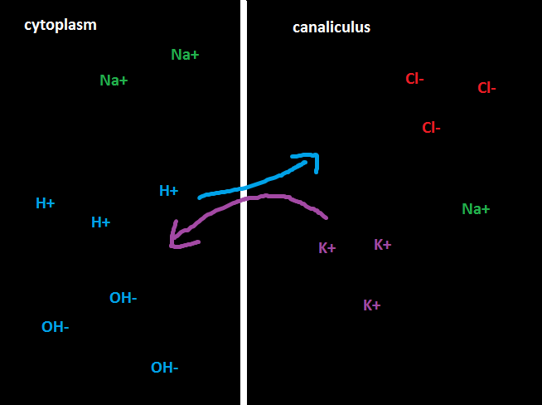
Acid secretion from the Parietal Cells

Slide 9
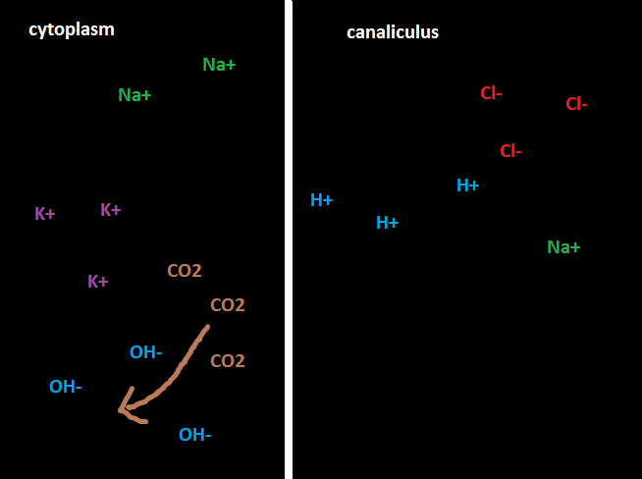
Acid secretion from the Parietal Cells

Slide 10
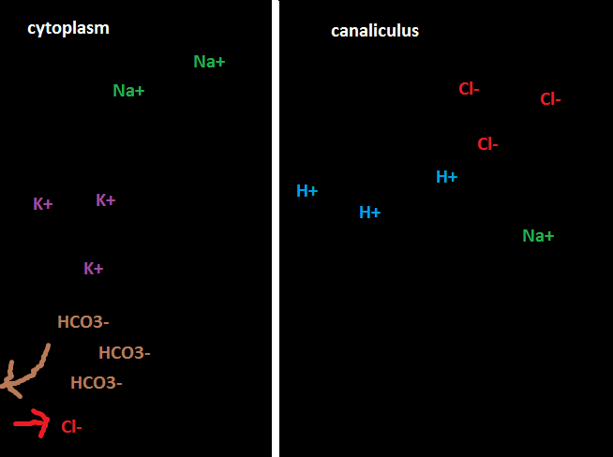
Acid secretion from the Parietal Cells

Slide 11
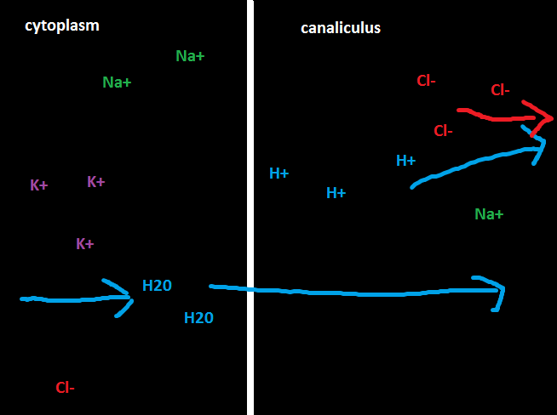
Acid secretion from the Parietal Cells

Slide 12
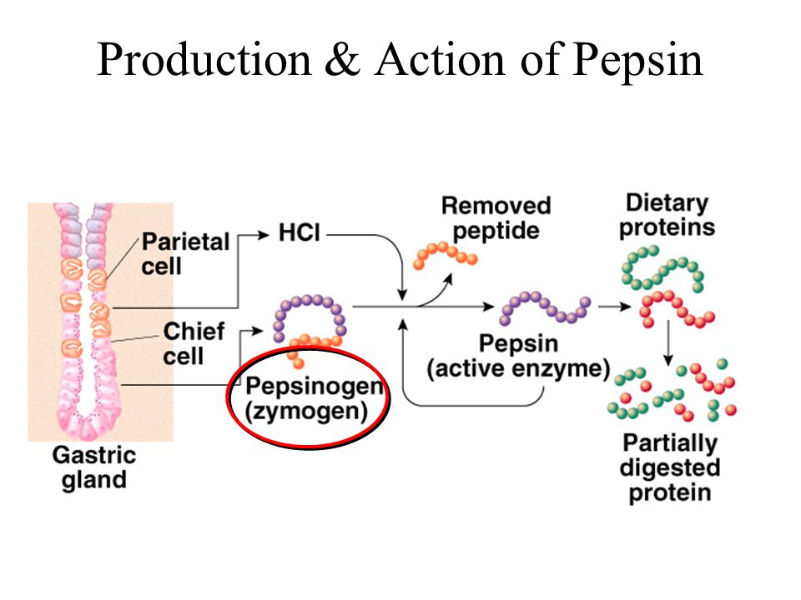
Peptic/ Chief Cells
What do they secrete?
Pepsinogen
When is it activated?
In low pH (2-3)
Important type of protein it breaks down?
Collagen

Slide 13
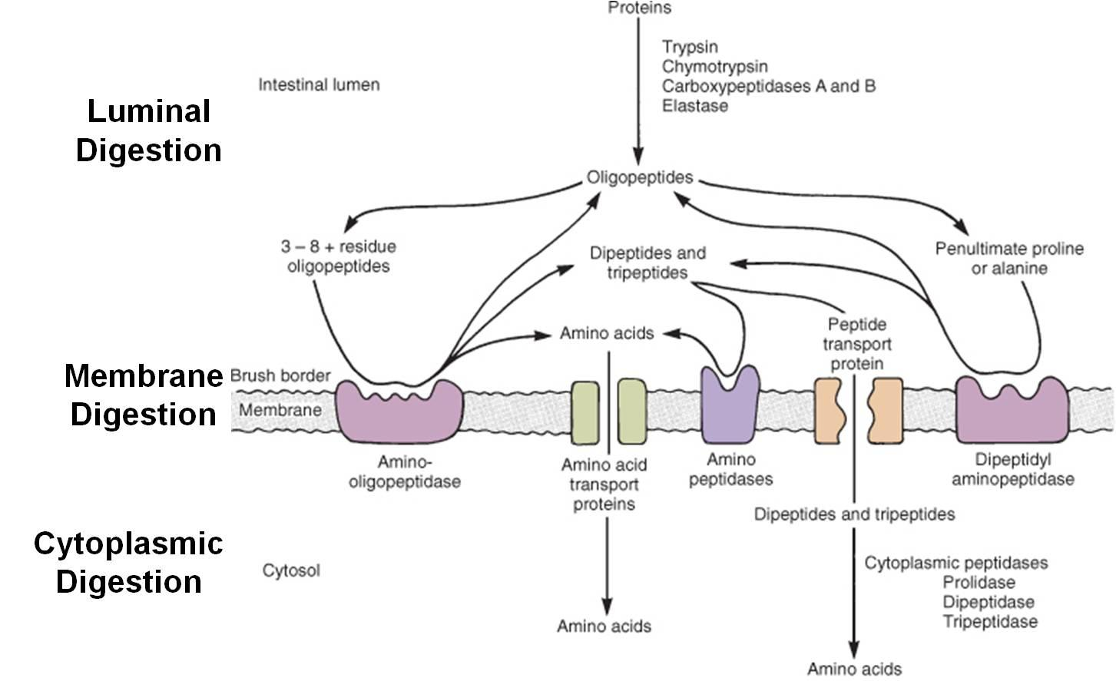
Small Intestine: Digestion
What are the enzymes released by the pancreas?
Trypsin, Chymotrypsin, Carboxypolypepidase, and Proelastase
What form are the proteins in now?
Dipeptides and Tripeptides
What other enzymes are there and where are they found?
Enterocytes – Aminopolypeptidase and dipeptidase
In cytosol- other peptides for specific linkages
Notes:
Typsin and Chymotrypsin split protein molecules into small polypeptides
carboxypolypeptidase cleaves individual animo acis from the carboxyl end of the polypeptides
proelastase -> elastase – digests elastin fibers that hold meat together

Slide 14
Liver Functions

Slide 15
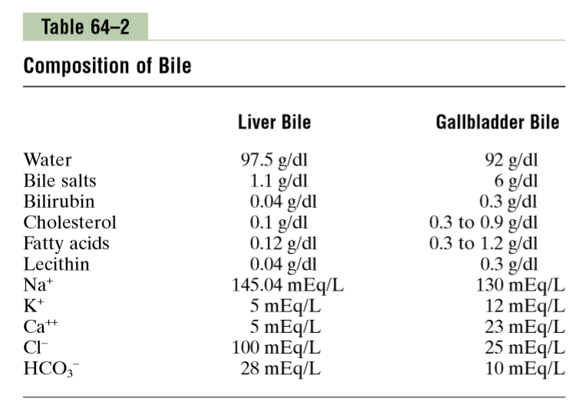
Liver Basics
What triggers release of material?
CCK, Ach, Secretin
What is released?
water, bile salts, waste, ions, Bicarbonate
What is the precursor to bile salts?
Cholesterol
What happens to the bile salts after they are used?
reabsorbed back into the hepatic cells then re-secreted into the bile- some excreted
Cholesterol
Cholic Acid or Chenodeoxycholic acid
glyco- and tauro- conjugated bile acids
salts from acids [sodium salts]
Fat metabolism in liver
Notes:
rhythmical contractions of the walls + relaxation of the sphincter of Oddi
Secretin also causes bicarbonate release from the gallbladder
sodium bicarbonate rich watery solution by epithelial cells of the bile ductules and ducts
liver parenchymal cells are not triggered
bile salts are formed in the hepatic cells from cholesterol in the blood plasma

Slide 16
Concentration of Bile
Based on the table – what is being absorbed while the Bile waits in the Gallbladder to be released?
Water, Sodium, Chloride
What is being condensed?
Bile Salts, Lecithin, and Cholesterol
Which one is dangerous?
Cholesterol can form gallbladder stones
Notes:
LESS-A-Thin
a substance widely distributed in animal tissues, egg yolk, and some higher plants, consisting of phospholipids linked to choline.

Slide 17
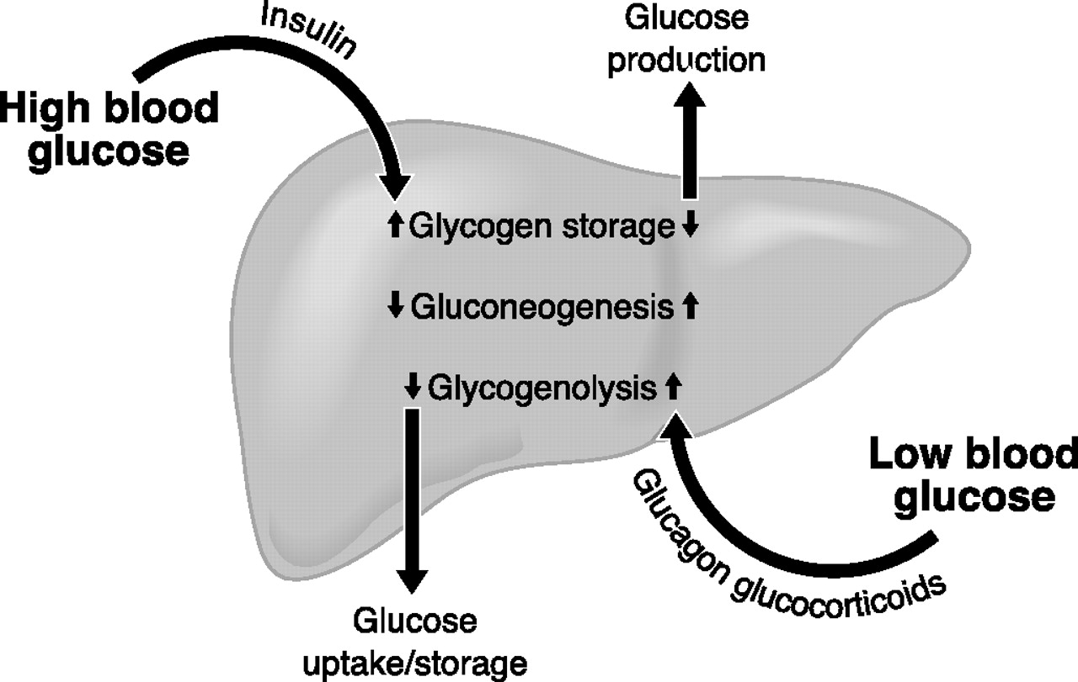
Why is the liver important for carbohydrates?
Storage of glycogen
Conversion of galactose and fructose to glucose
Gluconeogenesis
“Glucose Buffer Function” – remove extra glucose and then add it back when it is needed
Notes:
Gluconeogenesis (GNG) is a metabolic pathway that results in the generation of glucose from non-carbohydrate carbon substrates such as pyruvate, lactate, glycerol, and glucogenic amino acids.

Slide 18
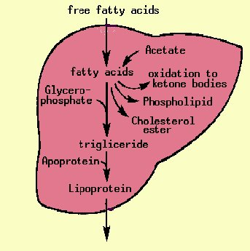
Why is the liver important for Fat?
Oxidation of Fatty Acids -> Acetyl CoA -> ATP
Synthesis of cholesterol, phospholipids, and lipoproteins
Cholesterol into bile salts
Cell membranes
Synthesis fat from proteins and carbohydrates
Bile salt digestion

Slide 19
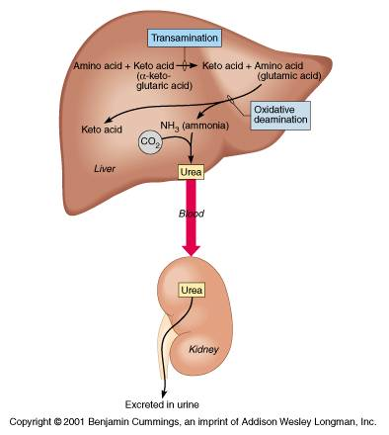
Why is the liver important for proteins?
Deamination of amino acids – for energy and converted to carbohydrates or fat
Formation of urea to remove ammonia
Formation of plasma proteins
Interconversion of various amino acids

Slide 20
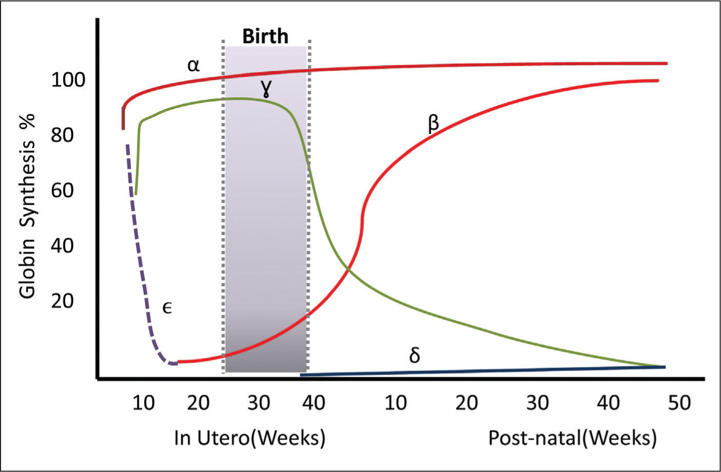
Newborn hemoglobin is different
Why is this important? What will it cause and why?
Physical Jaundice- typical bilirubin build up due to lack of liver maturity- goes away on it’s own
Pathological Jaundice- error in metabolism or other pathological problems- shows up quick and might not go away
Breastfeeding jaundice- irregular feeding means irregular bowl movements = slower excretion of bilirubin
Breastmilk jaundice- from substance in milk

