Slide 1
Smooth Vs Skeletal Muscle

Slide 2
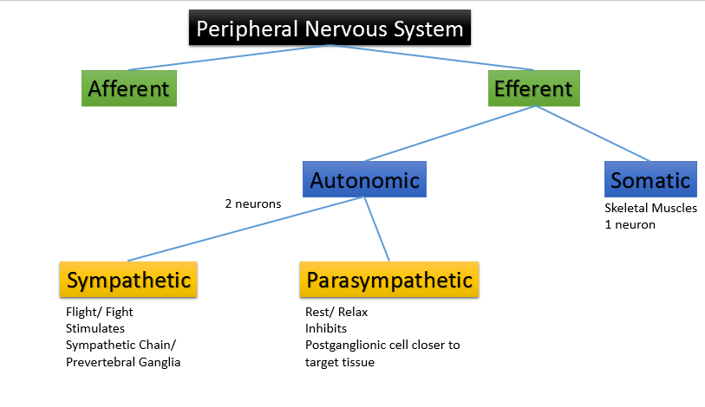
Nervous System
Somatic
Autonomic

Slide 3
Examples?
Skeletal Muscles- Biceps, triceps
Visceral organs- bladder, stomach; eye

Slide 4
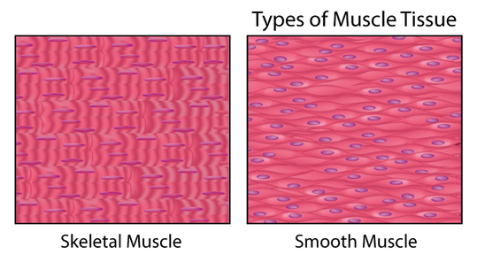
Organization
Striated
Not Striated

Slide 5
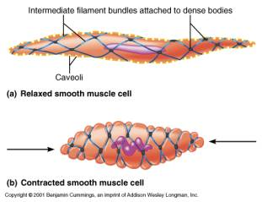
Attachment system for actin
Z-line
Dense Bodies

Slide 6
Length of Contraction (time)
20-200 ms
200 ms - sustained

Slide 7
Amount of Needed Energy
More ATP
Less ATP
Fraction of time the cross-bridge remains for Smooth is much longer
Less ATPase activity
Slower rate of cycling

Slide 8
Amount of Myosin
More Myosin
Less Myosin

Slide 9
Amount of Force Generated
Less Force
More Force

Slide 10
What causes the initial stimulus?
Neurotransmitter at the Neuromuscular Junction
Nerve stimulation- Neurotransmitter, hormonal stimulation, stretch of the fiber, chemical change in environment

Slide 11
Number of types of receptor proteins
Few
Greater

Slide 12
Junction organization
Organized Neuromuscular Junction
Diffuse Junction with Varicosities that contain neurotransmitters
Contact Junctions for Multi-Unit type smooth muscle

Slide 13
Responsible for action potential (which cation)
Sodium
Calcium- more Ca voltage gated channels than Na voltage gated channels
They open slower and longer

Slide 14
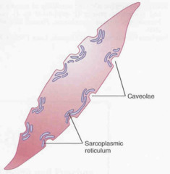
Invaginations
T- Tubule
Caveolae

Slide 15
Contraction in Muscles stimulated by increase in
Calcium
Calcium

Slide 16
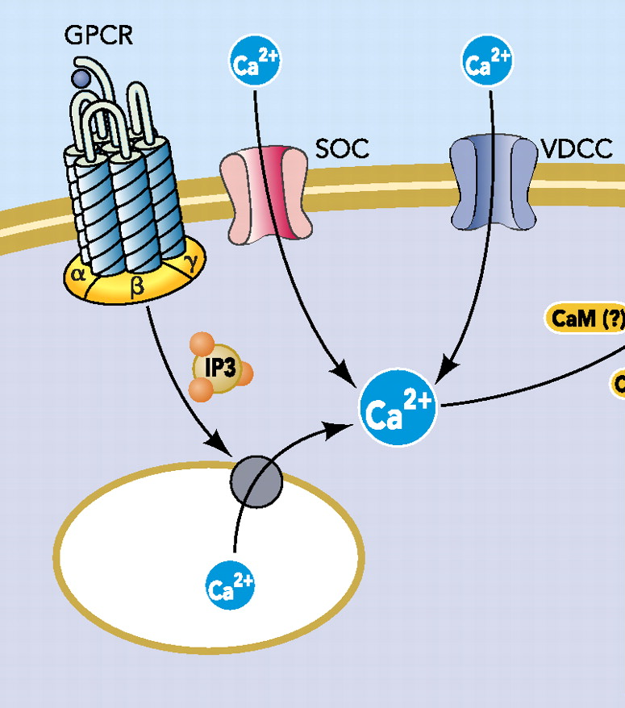
Calcium enters cell from Extracellular space via what channel?
DHP
Voltage gated Calcium channels
Store operated Ca Channels

Slide 17
Calcium enters cell from Extracellular space via what channel?
DHP
Voltage gated Calcium channels
Store operated Ca Channels
Is this necessary for contraction?
No
Yes

Slide 18
Calcium enters the cell from the SR via what channels?
RYR
Calcium induced Calcium released channel or IP3 mediated

Slide 19
Calcium binds to what proteins
Troponin
Calmodulin

Slide 20
What about the protein/ calcium binding allows for cross bridge cycling?
Troponin causes Tropomyosin to move
Calmodulin binds to Myosin Light Chain Kinase which can now phosphorylate the light chain of myosin

Slide 21
Do you need ATP?
Yes
Yes

Slide 22
What stops contractions?
Fall in Calcium
Fall in Calcium and Myosin Light Chain Phosphatase (Split in Phosphate from the regulatory light chain)

Slide 23
Can Contraction Continue if Calcium is Removed?
No
Yes – if there is no phosphatase enzyme
“Latch Phenomenon”

Slide 24
What removes Calcium from the cell?
Na/Ca Pumps on cell membrane, Ca ATPase on cell membrane and SR membrane
Na/Ca Pumps on cell membrane, Ca ATPase on cell membrane and SR membrane

Slide 25
What would happen to the smooth muscles around your arterioles if a bear walked in?
And Why?

Slide 26
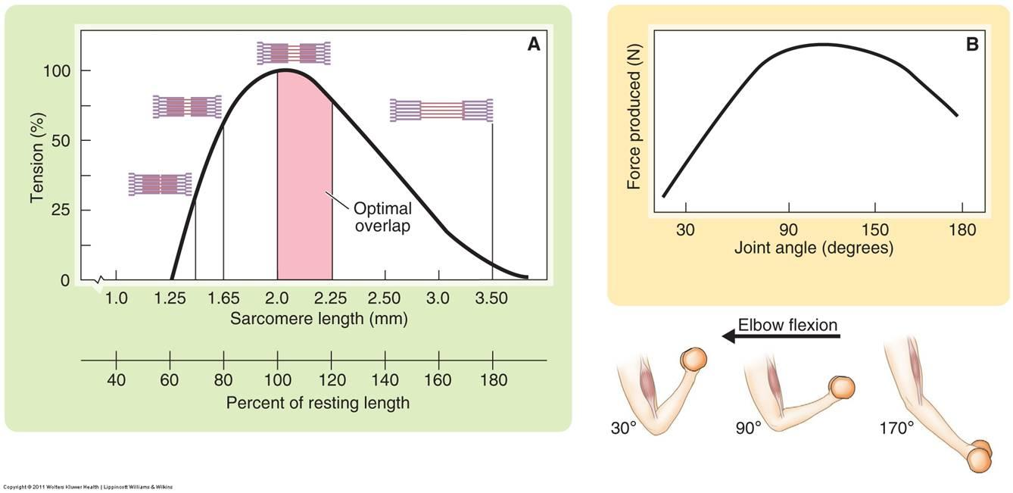
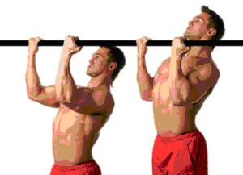
Why is it easier to do a pull up if you don’t full lock out your elbows?
And Why?

